Slide 1


Data Structures
(Introduction)
Ahmed Makki

Slide 2
What is a Program?
Program = Data Structure + Algorithm
A program is simply a collection of instructions that can be executed by a computer to perform a specific task

Slide 3
Data Structure
Data Structure = Primitive data types + rules
It is the logical basis for organising information in the computer; for representation of data types and operations, subject to the language constraints.
It is a systematic way of organising and accessing data.
Data Structures in Everyday Life
Shopping list
List of daily tasks
Telephone directory

Slide 4
Abstract Data Types
Data abstraction asks that you to think in terms of what you can do to a collection of data independently and of how you do it.
An Abstract Data Type (ADT) is:
a collection of data and
a set of operations on that data.
A data structure is a construct within a programming language that stores a collection of data.
ArrayList
Stack
Queue

Slide 5
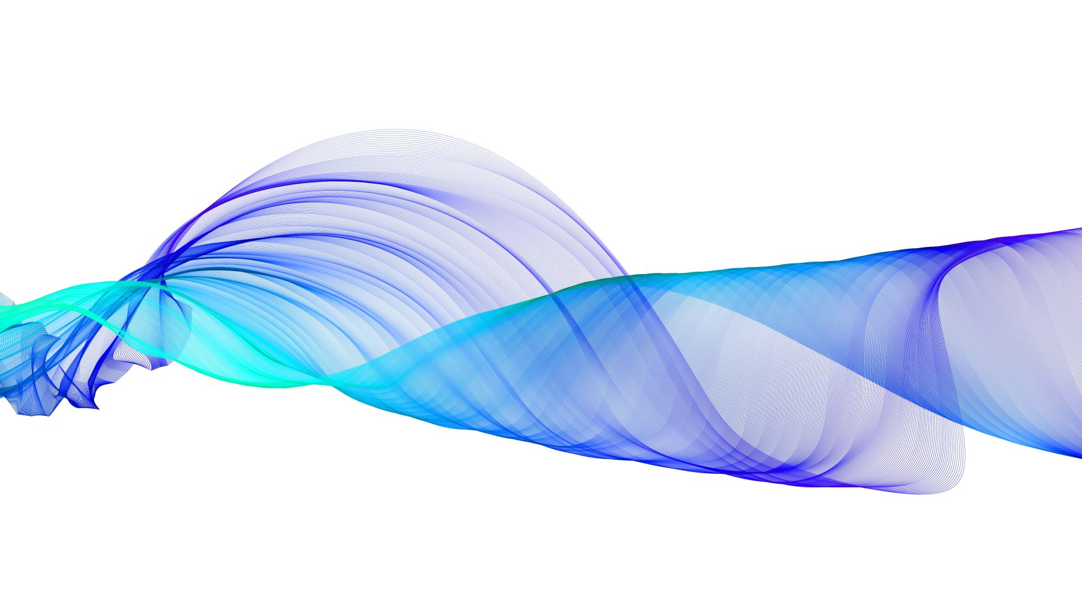
Data Structure
Characteristics of Data Structures
Characteristics of Data Structures
homogeneous / heterogeneous
built in / DIY
static / dynamic
sequential / linked / non linear
Which data structure/algorithm/etc. is best?
it’s a trade off
Ferrari vs. Skoda! (speed/economy, fin. outlay/status)
ordered list vs unordered list
construction time vs. access time

Slide 6
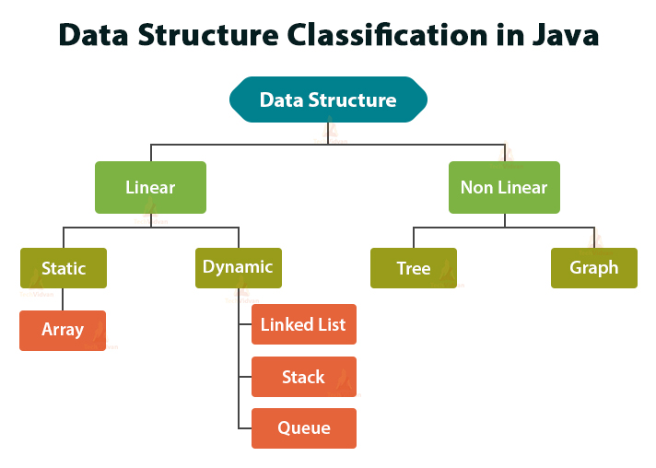
Abstract Data Types

Slide 7
Data Structure
Examples of Linear Data Structures
ArrayList
An auto resizing array that can hold any type of object
Operations: Add/search/remove/get an element/parse/print elements
ArrayList<String> words;
words = new ArrayList<String>();
Stack
A container of objects that are inserted and removed according to the last-in-first-out (LIFO) principle
Queue
A container of objects that are inserted and removed according to the first-in-first-out (FIFO) principle

Slide 8
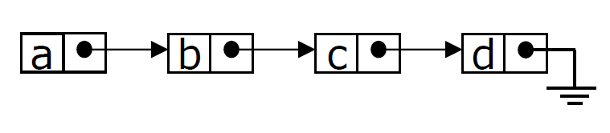
Data Structure
Examples of Linear Data Structures
Priority Queue
Stores a collection of prioritised elements.
Removal of elements only in order of priority.
Single and Double Linked Lists
A sequence of connected nodes
Each node contains:
an object and
link(s) (pointer or reference) to its successor (and predecessor)

Slide 9
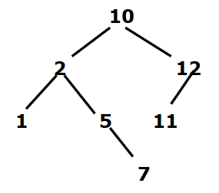
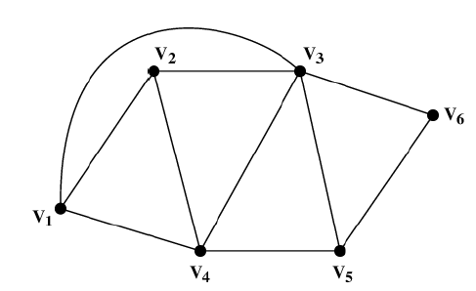
Data Structure
Examples of Non-Linear Data Structures
Trees / Binary Trees / Search Trees
a data structure that stores elements hierarchically (non linear).
No cycle exists.
Graphs
a finite set of dots called nodes (or vertices) connected by links called edges (or arcs).
Simple/weighted/directed graphs:

Slide 10
Algorithm
What is an Algorithm?
It is a precisely specified procedure for solving a problem.
It is a problem solving method suitable for implementation as computer programs.
It is a step by step procedure for performing some tasks in a finite amount of time.

Slide 11
Algorithm
Algorithm Definition
Algorithm is a precise sequence of actions for performing a computational task, independent from computer languages (i.e. pseudocode)
Example of Algorithms:
Cooking Recipe
Route from NCI College to the home
Knitting pattern
Shortest path between two cities on a map
More than one algorithm possible for the same task

Slide 12
Algorithm
Role of Algorithms in the Real World
Enormous amount of data
World Wide Web (Web pages)
E-commerce (Amazon, Ebay)
Network traffic
Database transactions (Sales, inventory)
Scientific measurements (astrophysics, geology)
Sensor networks
Problem: how does Google find web pages matching your query so fast?
Uses sophisticated algorithms to create index structures, which are just data structures.

Slide 13
Algorithm
Role of Algorithms in the Real World
With the big amount of data produced by the new technologies, there is a need to organize, search, and update fast massive amount of information
Algorithms are used to process data
Which are the top 10 sellers on eBay?
What is the correlation between time spent on a web site and
purchase amount
What is the shortest path between two points on a map?

Slide 14
Algorithm
Five Features of an Algorithm (Knuth)
1. Finiteness:
The algorithm must terminate after a finite number of steps.
2. Definiteness:
Each step of the algorithm must be precisely defined and the action to be executed must be rigorous and unambiguously specified.
3. Input:
It has zero or more inputs quantities initially given before it begins.
4. Output:
The algorithm has one or more outputs
5. Effectiveness:
The algorithm is expected to be effective.

Slide 15
Java Collection Framework
https://docs.oracle.com/javase/8/docs/technotes/guides/collections/index.html
API Specification
https://docs.oracle.com/javase/8/docs/api/

Slide 16
Java Collection Framework
Principles
A collection (container or object) is simply an object that represents group multiple elements (objects) as a single unit.
It allows us to create an empty collection, add and remove items, and determine whether a particular item occurs in the collection.
A collections framework is a unified architecture for representing and manipulating collections.
Collections framework classes are part of java.util package.
So, you have to import java.util.*; in order to use these classes.

Slide 17
Java Collection Framework
Benefits
It reduces programming effort:
By providing useful data structures and algorithms, so we don’t have to worry about writing them ourselves.
It increases program speed and quality:
By providing high-performance, high-quality implementations of useful data structures and algorithms.
It reduces the effort to learn and use APIs
It reduces effort needed to design and implement APIs
It fosters software reuse

Slide 18
Java Collection Framework
The Java Collections framework consist of collection interfaces. The collection interfaces are divided into two groups, namely: java.util.Collection (the most basic interface) and java.util.Map (other collection interfaces which are not true collections).
A set of classes supported by the Java Collection Framework are listed below:
List – Array
LinkedList
ArrayList
Vector
Map – Key/Value
TreeMap
HashMap

Slide 19
Java Collection Framework
Methods provided by Java Collections
Most common methods provided by the majority of Java classes that implement different type of Java Collections
add(Object obj) - Appends the specified element to the end of the collection
add(int index, Object obj) - Inserts the specified element at the specified position in the collection (index>=0, index<size())
remove(Object obj) - Removes the specified the element from the collection
remove(int index) - Removes the element at the specified position in the collection.

Slide 20
Java Collection Framework
Some other methods provided by Java Collections
isEmpty() - Returns true when the collection is empty
indexOf(Object obj) - Returns the index of the first occurrence of the object,
Returns -1 when element is not found
size() - Returns the size of the collection
sort (Collection myCollection) - Sorts the collection according to ascending order
shuffle(Collection myCollection) - Rearranges the elements from the collection in some random way.

Slide 21
THE END

